Slide 1
Introduction
Computer Science: An Overview

Slide 2
Chapter 0: Introduction
0.1 The Role of Algorithms
0.2 The Origins of Computing Machines
0.3 The Science of Algorithms
0.4 Abstraction
0.5 An Outline of Our Study
0.6 Social Repercussions
0-<number>

Slide 3
Terminology
Algorithm: A set of steps that defines how a task is performed
Program: A representation of an algorithm
Programming: The process of developing a program
Software: Programs and algorithms
Hardware: Equipment
0-<number>

Slide 4
History of Algorithms
The study of algorithms was originally a subject in mathematics.
Early examples of algorithms
  Long division algorithm
  Euclidean Algorithm
Gödel's Incompleteness Theorem: Some problems cannot be solved by algorithms.
0-<number>

Slide 5
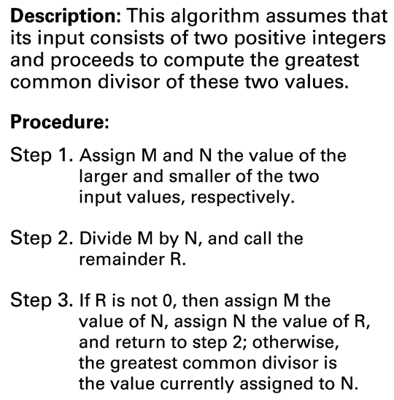
Figure 0.2 The Euclidean algorithm
0-<number>

Slide 6
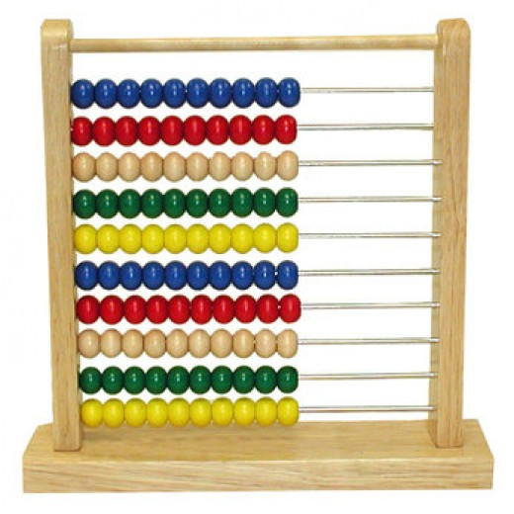
Origins of Computing Machines
Early computing devices
  Abacus: positions of beads represent numbers
0-<number>

Slide 7
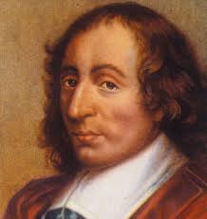
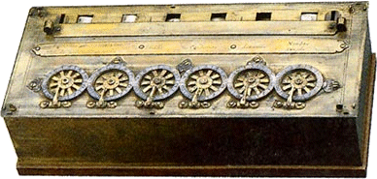
Origins of Computing Machines
  Gear-based machines (1600s-1800s)
    Positions of gears represent numbers
    Blaise Pascal
0-<number>

Slide 8
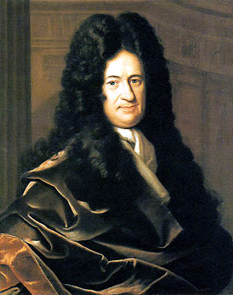
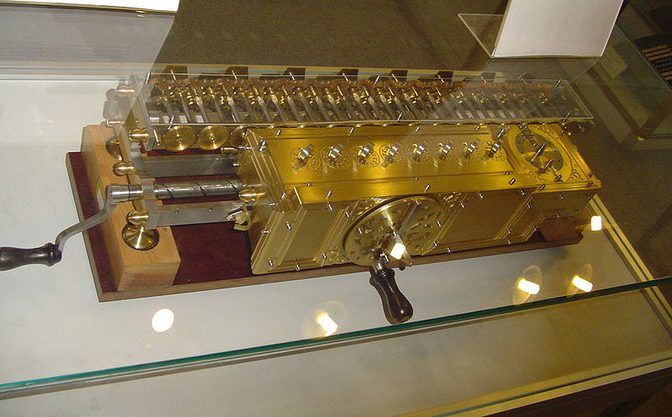
Origins of Computing Machines
  Gear-based machines (1600s-1800s)
    Positions of gears represent numbers
    Wilhelm Leibniz
0-<number>

Slide 9
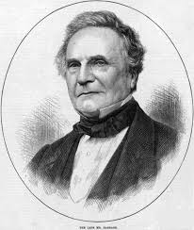
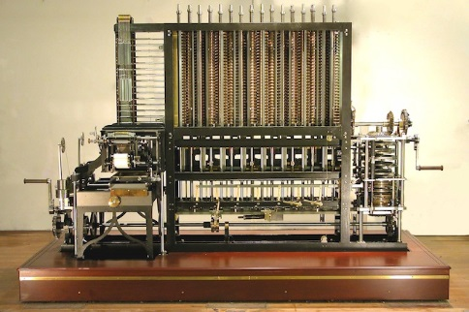
Origins of Computing Machines
  Gear-based machines (1600s-1800s)
    Positions of gears represent numbers
    Charles Babbage
0-<number>

Slide 10
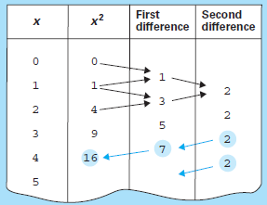
Origins of Computing Machines
  Gear-based machines (1600s-1800s)
    Positions of gears represent numbers
    Charles Babbage
0-<number>

Slide 11

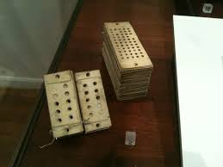
Origins of Computing Machines
  Gear-based machines (1600s-1800s)
    Positions of gears represent numbers
    Charles Babbage (Joseph Jacquard)
0-<number>

Slide 12
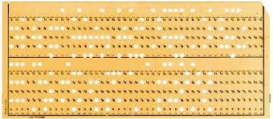
Origins of Computing Machines
  Gear-based machines (1600s-1800s)
    Positions of gears represent numbers
    Herman Hollerith
0-<number>

Slide 13
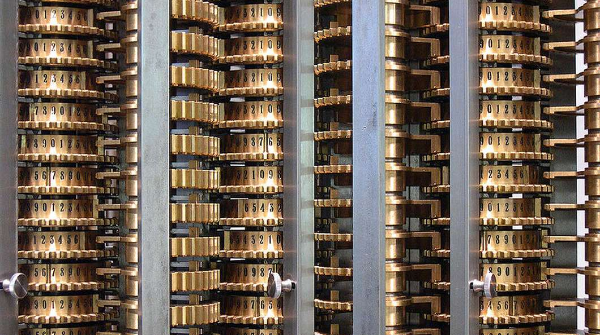
Early Data Storage
Punched cards
  First used in Jacquard Loom (1801) to store patterns for weaving cloth
  Storage of programs in Babbage’s Analytical Engine
  Popular through the 1970’s
Gear positions
0-<number>

Slide 14
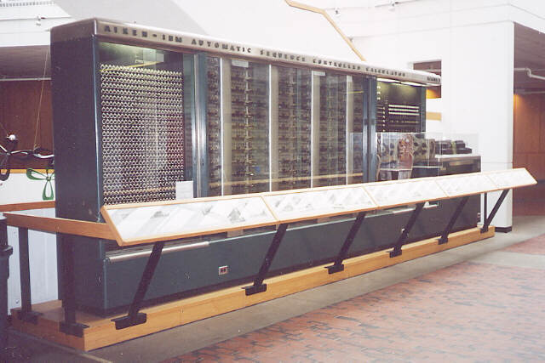
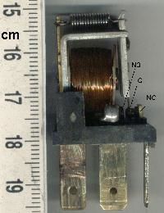
Early Computers
Based on mechanical relays
  1940: Stibitz at Bell Laboratories
  1944: Mark I: Howard Aiken and IBM at Harvard
0-<number>

Slide 15
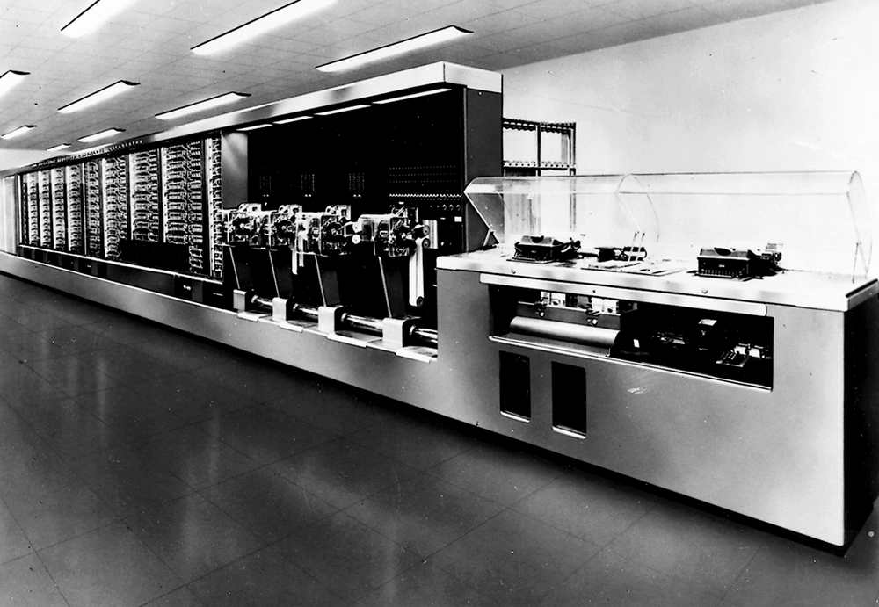
Figure 0.4 The Mark I computer
0-<number>

Slide 16
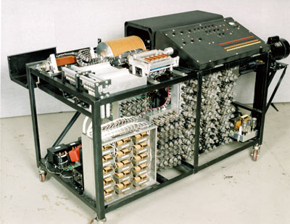
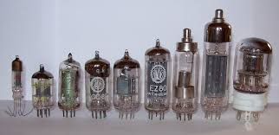
Early Computers
Based on vacuum tubes : 1937-1941: Atanasoff-Berry at Iowa State / linear equations
0-<number>

Slide 17
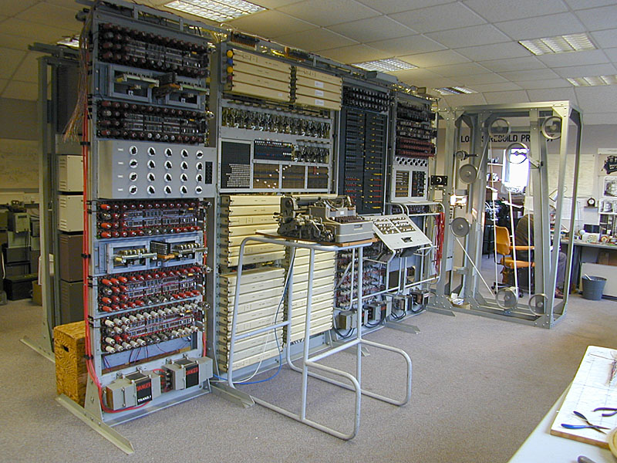
Early Computers
Based on vacuum tubes
  1940s: Colossus: secret German code-breaker, first programmable, electronic, digital computer, although it was programmed by plugs and switches and not by a stored program
0-<number>

Slide 18
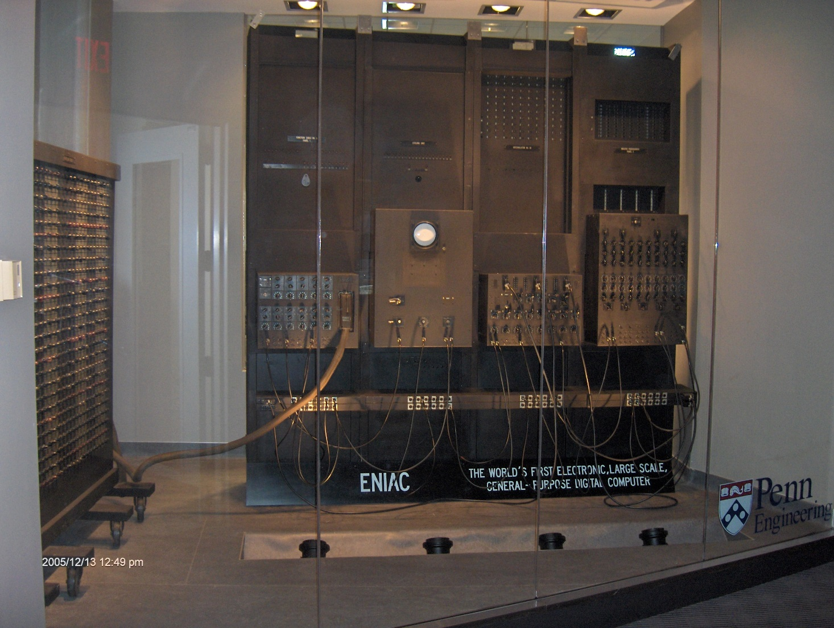
Early Computers
Based on vacuum tubes
  1940s: ENIAC: Mauchly & Eckert at U. of Penn.
0-<number>

Slide 19
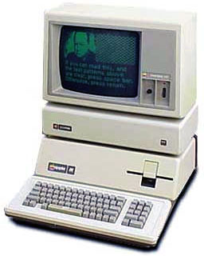
Personal Computers
  The first personal computer.
  1975, came as kits: The MITS Altair 8800, followed by the IMSAI 8080, an Altair clone.
0-<number>

Slide 20
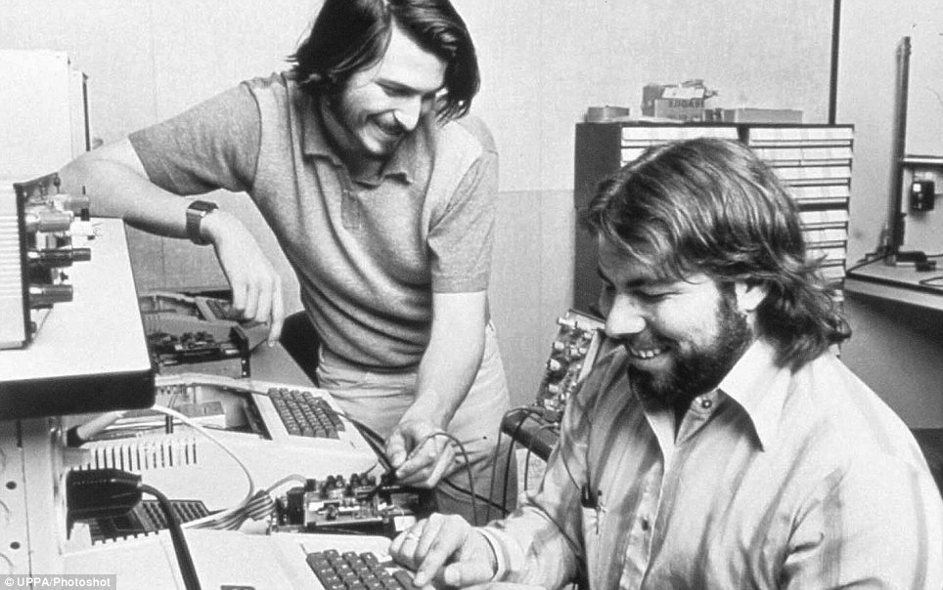
Personal Computers
  The first personal computer.
  1975, came as kits: The MITS Altair 8800, followed by the IMSAI 8080, an Altair clone.
0-<number>

Slide 21
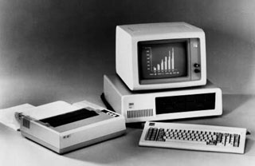
Personal Computers
  First used by hobbyists
  IBM introduced the PC in 1981.
    Accepted by business
    Became the standard hardware design for most desktop computers
    Most PCs use software from Microsoft
0-<number>

Slide 22
Into the Millennia
Internet revolutionized communications
  World Wide Web
  Search Engines (Google, Yahoo, and Microsoft)
Miniaturization of computing machines
  Embedded (GPS, in automobile engines)
  Smartphone
0-<number>

Slide 23
Computer Science
The science of algorithms
Draws from other subjects, including
  Mathematics
  Engineering
  Psychology
  Business Administration
  Psychology
0-<number>

Slide 24
Computer Science
Write an Algorithm to Swap two numbers!
0-<number>

Slide 25
Computer Science
Write an algorithm to Sort given numbers in Ascending Order.
0-<number>

Slide 26
Computer Science
Mortal Matrix Problem !!!!!!!!!!!!!!!!!!!!!!!!
Given more than six (3,3) square matrices, decide whether the semigroup (*) that they generate contains the zero matrix.
0-<number>

Slide 27
Central Questions of Computer Science
Which problems can be solved by algorithmic processes?
How can algorithm discovery be made easier?
How can techniques of representing and communicating algorithms be improved?
How can characteristics of different algorithms be analyzed and compared?
0-<number>

Slide 28
Central Questions of Computer Science (continued)
How can algorithms be used to manipulate information?
How can algorithms be applied to produce intelligent behavior?
How does the application of algorithms affect society?
0-<number>

Slide 29
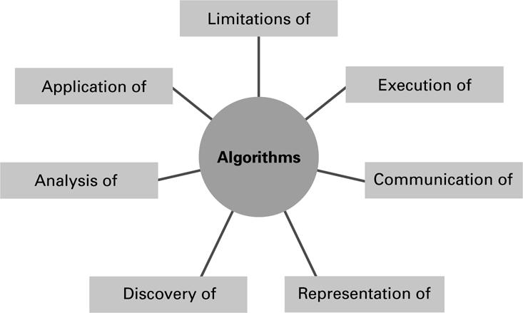
Figure 0.5 The central role of algorithms in computer science
0-<number>

Slide 30
Abstraction
Abstraction: The distinction between the external properties of an entity and the details of the entity’s internal composition
Abstract tool: A “component” that can be used without concern for the component’s internal properties
0-<number>

Slide 31
Outline of Our Study
Data Storage
Data Manipulation
Operating Systems
Networks and the Internet
Software Engineering
Database Systems
Computer Graphics
Artificial Intelligence
0-<number>

Slide 32
Social Repercussions
Advances in computer science raise new questions.
  In law: Questions of rights and liabilities
  In government: Questions of regulation
  In the work place: Questions of professionalism
  In society: Questions of social behavior
0-<number>

Slide 33
Social Issues
Is our society better than it would have been without the revolution? Is our society worse?
Is it acceptable to participate in today’s technical society without making an effort to understand the basics of that technology?
Traditionally using cash in financial transactions without transaction charges

Slide 34
Social issues
Interactive television - to what extent should a company be allowed to retrieve information from children
To what extent should a government regulate computer technology and its
applications?
To what extent will our decisions regarding technology in general, and computer technology in particular, affect future generations?

Slide 35
Social Issues
Educational system is constantly challenged to reconsider the level of abstraction at which topics are presented E.g., use of calculator for trignometry (abstraction)
Should public libraries be the channel by which information access is provided
Ethical concerns arise in a society that relies on the use of abstract tools?

Slide 36
Social Issues
As our society becomes more automated, it becomes easier for governments to monitor their citizens’ activities. Is that good or bad?
Could your choice of technologies be taken with you without taking others? E.g., Time Machine
To what extent can one technology be separated from another?

Slide 37
Social Issues
Is it consistent to protest against global warming yet accept modern medical treatment?
Suppose your job requires that you reside in another culture. Should you continue to practice the ethics of your native culture or adopt the ethics of your host culture? Does your answer depend on whether the issue involves dress code or human rights?

Slide 38
Social Issues
Which ethical standards should prevail if you continue to reside in your native culture but conduct business with a foreign culture on the Internet?
Has society become too dependent on computer applications for commerce, communications, or social interactions? For example, what would be the consequences of a long-term interruption in Internet and/or cellular phone service?

Slide 39
Social Issues
Most smartphones are able to identify the phone’s location by means of GPS. This allows applications to provide location-specific information (such as the local news, local weather, or the presence of businesses in the immediate area) based on the phone’s current location.
However, such GPS capabilities may also allow other applications to broadcast the phone’s location to other parties.
Is this good? How could knowledge of the phone’s location (thus your location) be abused?

Slide 40
Ethical Theories
Consequence based:
What leads to the greatest benefit?
Duty based:
What are my intrinsic obligations?
Contract based:
What contracts must I honor?
Character based:
Who do I want to be?
0-<number>

